Slide 1



REACH OUT STAY STRONG
ESSENTIALS
ROSE
Notes:
SKIP New Outline

Slide 2
Session D
Review
Introduction
Review Homework
  Pleasant activities and relaxation exercises
  How did it go asking for help or making and assertive request?
  Today’s session is about asking for Help
  Planning for the future: My Goals
  ROSE Final Tips

Slide 3

Assertiveness Review
  What is it?
  Assertiveness is the ability to express your thoughts and feelings openly and directly to others, without “turning them off.
  You have to recognize others have rights, as well as yourself.
Non-Assertive Behavior
    You do not express your own wants, needs, or ideas. You ignore your own rights.
Aggressive Behavior
    express their feelings and needs at the expense of others. They violate the rights of others.

Slide 4
Session D
Barriers to Assertiveness
Lots of thing can get in the way of being assertive or asking for help. What are some of the stumbling blocks to being assertive?

Slide 5
ASKING FOR HELP
“Our society has put women in a position to think that they must do it all. Supermoms, in reality, are few and far between.”
Carol
“Asking for help brings up feelings of failure.”
“Asking for help brings up feelings of failure.”
Tammy
Asking for help is hard. There are many reasons why women don’t feel comfortable asking for or accepting help

Slide 6



Asking for Help: Who, Me? Needy?
“For the first time, I realized I needed help.”
Laurie
“You never know what kind of reaction you will get. My mom said, ‘you just have to deal with it.’ This attitude just shuts people down.”
Gaye

Slide 7
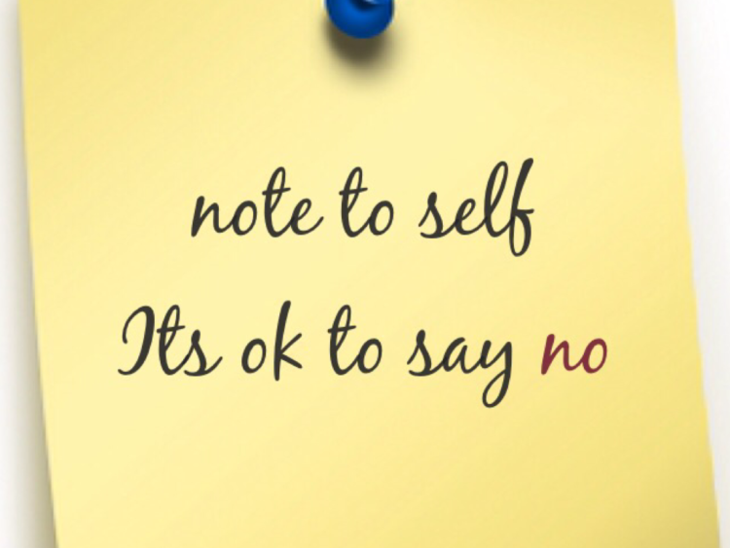
Assertiveness Review
Barriers To Assertiveness
Importance of saying NO

Slide 8
Session D
Saying No
Importance of saying no
  Double load when baby is here, cannot do it all.
  Need to say no to keep a balance in your life.
  Have the right to say no
Strategies :
  Delay an immediate response
  A partial no that works for you
When would you have liked to say no but didn’t?

Slide 9
Saying No
Let’s take those situations where you would have liked to have said “No” and give you the opportunity to say “No” now using the strategies we have discussed today and last session.
Let’s role play it!

Slide 10

HOLD ON TO YOUR DREAMS
INFANCY
DOES NOT LAST FOREVER!

Slide 11
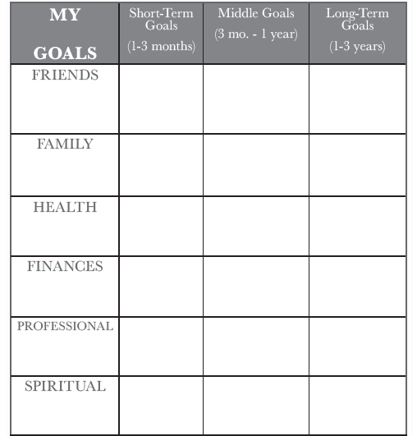
Planning for the Future

Slide 12
My Resources
When I am feeling down or overwhelmed, I can reach out to the following people/resources:
NAME:
1.__________________
2.__________________
3.__________________
4._________________
5.__________________
PHONE NUMBER:
1. __________________
2._________________
3._________________
4._________________
5._________________
*Remember to use this sheet as a reference if you are feeling overwhelmed or need assistance.*

Slide 13
Rose Final Tips
PLEASANT ACTIVITIES
Remember it is important to nurture yourself, and to develop new ways of doing so (if necessary).
Adding in positive activities can lessen distress and increase your energy and positive outlook.
Remember your pleasant activity contract.
RELAXATION
Learning how to manage stress will make you feel better, increase your sense of control, and empower you.
Remember to do your relaxation exercises.
take time out for YOU. Rest means rest (no chores).
CHANGES: BECOMING A NEW MOM
Big changes in life, like having a baby, can be stressful.
Becoming a new mom involves new demands and losses.
You may feel fearful, sad, tense, & frustrated - remember you are not alone and you re not to blame.
It is important to talk about your feelings, reach out.
It is important to replace lost goals when experiencing losses and changes in life. There are both short-term goals (baby steps) and long-term goals.
Set ongoing goals. (Infancy does not last forever).

Slide 14

Rose Tips
DEALING WITH RELATIONSHIPS
You have the right to ask for help and the right to say NO.
Relationships need constant work, especially when there are changes like having a new baby in your life.
Maintain balance in your relationships - demands must not outweigh your needs.

Slide 15
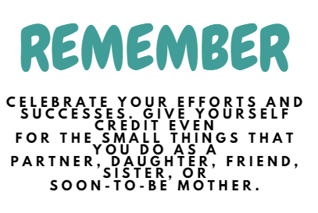

Slide 16
Wrap up
Assign Goal Setting Homework
Review handout ROSE Final Tips
If time, complete Handout on My Resources
Will follow up with postpartum phone call

