Slide 1



REACH OUT STAY STRONG
ESSENTIALS
ROSE
Notes:
SKIP New Outline

Slide 2
Session C
Reviewing Homework
Welcome and Check-in
Reviewing Homework
  How did the relaxation exercises go? How did you feel after?
  What pleasant activities did you do?

Slide 3
Session C
Relationships and Communication
Communicating with Loved Ones
Remembering your rights
Tips for asking others for help
Golden rules for being assertive

Slide 4

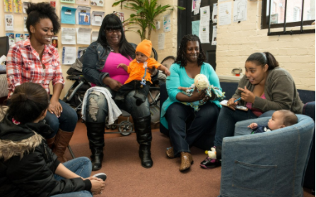
Relationships
Evaluate important adult relationships

Slide 5
Maintaining Healthy Relationships
Evaluating relationships
Write down the name of someone important to you and ask yourself?
How satisfying is the relationship?
Is it supportive overall?
Is it Safe?
How are problems dealt with?

Slide 6
COMMUNICATING WITH LOVED ONES
Choose one loved one you would like to improve your communication style with.
  What are your difficulties?
  Your concerns?
  What are your needs at this time?
  What are your goals for the relationship?

Slide 7


Communicating with Loved Ones
I would like to change my communication style with:
___________________________________________
1. How is your communication style going with this person? (-10 to 0, communication style is going extremely badly; 1 to 10, extremely well).
-10 -9 -8 -7 -6 -5 -4 -3 -2 -1 0 1 2 3 4 5 6 7 8 9 10
2. What are the two best things about how you communicate with this person? What kinds of things does this person say or do that make you happy? What makes this person special to you?
________________________________________________________________________________

Slide 8
Communicating with loved ones
1. What are the two worst things about how you communicate with this person? What kinds of things do they do that are hard on you? What kinds of things do they forget to do? Do you feel like you get enough time/attention/caring from this person?
___________________________________________________
2. Interpersonal goals: What kinds of changes or support would you like from this person, other than what he or she does now? It is ok to want a person to give more or less of something they already do. It is also ok to ask for support to mean that a person stops doing something that hurts someone’s feelings. If it is hard to identify kinds of support, sometimes it is helpful to think about what a person could possibly say or do that would be helpful.
____________________________________________________

Slide 9
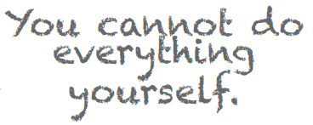


Remember Your Rights
It is OK to want or need something from someone else.
I can insist on my rights and still be a good person.
I sometimes have a right to assert myself, even if I may inconvenience others.
I may want to please people I care about, but I don’t have time to please them all of the time.
The fact that I say no to someone does not make me a selfish
person.
I can still feel good about
myself, even though
someone else is
annoyed with me.

Slide 10
Interpersonal disputes
Types of arguments that tend to take place within a relationship
  (1) “Give and take”: people are openly aware of differences, and are actively trying, even if unsuccessfully (talking but not fixing), to bring about changes.
  (2) Silently resentful: discussion has stopped, and resentment may continue to bubble.
  (3) Cannot be fixed: the relationship cannot be repaired, both parties are going there own way emotionally

Slide 11
Assertiveness
    How easy is it for you to ask for things?
    How well can you say no -Does it differ with different people?
    What is assertiveness?

Slide 12

Remember Your Rights

Slide 13

Tips For Asking For Help
TIMING:
Choose a quiet time. Introduce the fact that you want to talk about something.
NONVERBAL BEHAVIOR:
Use an appropriate tone of voice, avoid threatening posture, make eye contact with the other person, face them directly.
SAY SOMETHING
POSITIVE:
Sandwich the negative between positives. Start with a positive and end with a positive.

Slide 14
Assertiveness
Take your time (when saying no, “Can I let you know tomorrow?”)
Openly state your own feelings, or changes you would like.
Avoid any attacks on the other person, any threats, or insulting statements about the other person.
Avoid: “Never, should, and always.”
Deal with one issue at a time (in con-trast to “kitchen sinking”).
Criticize the behavior, not the person (say what you want them to do, not what you want them to be).
Ask them for what you want, (in contrast to telling them what they should do).
(“Thanks for being so understanding, I really appreciate it”).
Be willing to give to get.
Turn the table: Ask them, “what do you think we should do?”

Slide 15
Assertiveness
DON’T RULES INCLUDE:
Judge or blame
Over-apologize
Put yourself down
Guess the other person’s
intentions
Mind-read
Expect people to know what you want them to do if you don’t tell them
Give a whole list
(“kitchen sinking”)
Beat around the bush
Tell the other person

Slide 16
Making an Assertive Request
One change I will ask for this week
_________________________________________________
_________________________________________________
_________________________________________________
Because I want them to listen without feeling upset, I need to be careful to:
________________________________________________
_________________________________________________
_________________________________________________
Date I will try this on:
_________________________________________________
Person with whom I will try this:
_________________________________________________

Slide 17
Practice of Assertive Request
Let us as a group help you with what you could say that would be assertive
Remember what we have discussed today
You can write it down if helpful
Let’s role play!

Slide 18
Session C
Homework
  Complete Handout on relationship evaluation and changes for two important relationships.
  Practice making assertive requests
  Commit to 3 pleasant activities and relaxation
Wrap up
  Highlights of next session on___ at____, (trouble shoot any problems you had asking for help, negative communication, how to say no to a request, and how to plan for your future)

