Slide 1

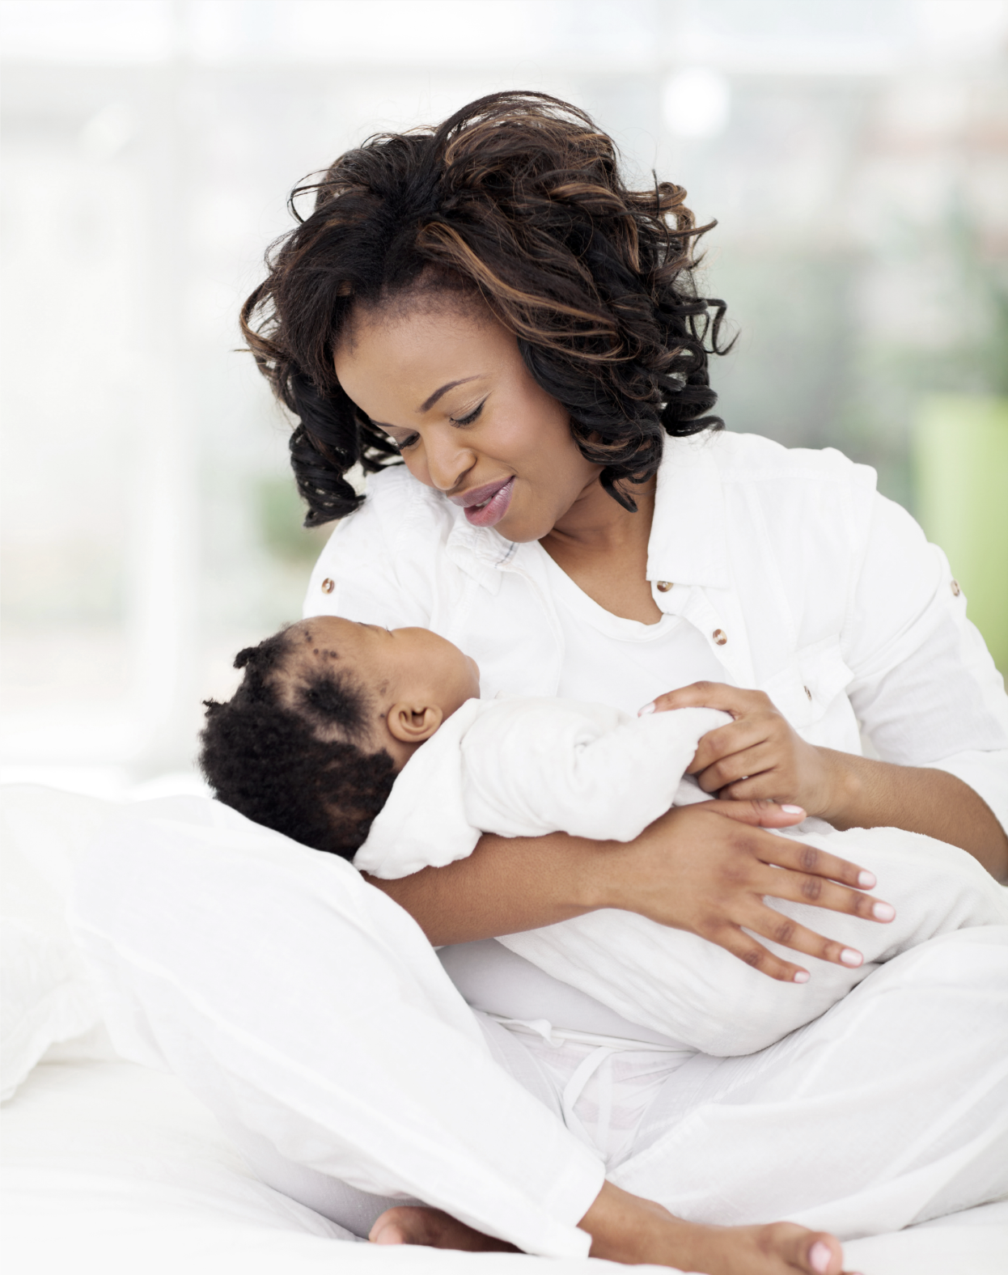

REACH OUT STAY STRONG
ESSENTIALS
ROSE
Notes:
SKIP New Outline

Slide 2
Session B: Being a Mother
Decreasing Stress
Changing Roles
Mothers Survival Kit
Increasing Pleasant Activities
My Close People

Slide 3
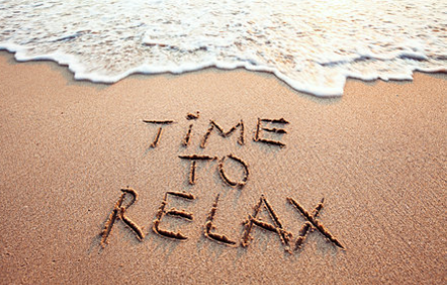
Relaxation Exercise

Slide 4

Decreasing Stress Progressive Relaxation Exercise
I want you to make yourself comfortable.
If you want, you can close your eyes.
We are going to start with your feet - curl your toes,
and relax them.
Now dig your heels into the ground and feel the tightness in your legs and relax - good. Your legs feel loose and heavy.
Now tighten your stomach - hold, feel the tightness and release - very good.
Now I want you to arch your back - feel the tension in your spine and relax your back - just let go - let all the tension leave your body - good.
Make a fist with your hands and slowly raise them to your shoulder - feel the tightness in your arms and let go - just let your arms drop to your side and be loose and heavy, good.
Now raise your shoulders to your ears - feel the tightness in your neck, hold and release - let all the tension go.
I want you to now tighten your mouth as tight as you can - feel the tight-ness in your jaw - good and just relax.
Take a deep breath in - and exhale - just feel all the tension leave your body.
Now tighten your eyes as tight as you can squeeze them - and let go of your body, so it feels nice and relaxed - good, very good. Focus on how calm and relaxed you feel - think of yourself on a soft cloud-feel the soft-ness of the cloud and sink into the cloud - your body feels so loose and heavy. Feel the warm sun on your body and the cool breeze on your face.
Just relax - you feel so peaceful and so safe.
(pause)
Now I am going to count backwards from 5 and when I get to 1, you are going to open your eyes slowly and the feeling of calm and peace will stay with you for the rest of the day.
Breath in 5 . . . and exhale calm
Breath in 4 . . . and exhale calm
Breath in 3 . . . and exhale calm
Breath in 2 . . . and exhale calm
Breath in 1 . . . and out . . . . think calm
As you slowly open your eyes, the calm and peace will stay with you.
http://www.publichealth.msu.edu/flint-research/the-rose-sustainment-study/9-flint/97- decreas-ing-stress-activity

Slide 5
Role transitions
Positive and negatives changes of becoming a mother
GAINS
Slow your pace
Spend time with your baby
Discover hidden talents
Learn new things
Nice excuse out of chores
Reactions that the baby has
Growth of the baby.
LOSSES
Loss of routine
More house hold chores
less time for partner
Loss of productivity
Loss of social life
Loss of space
Isolation

Slide 6
Nurturing The New Mother
Self Care
Pleasant activities (P.14)
Mother’s Survival Kit (P. 15)

Slide 7

Treat yourself
You deserve it
This is an
important
time to take
care of yourself

Slide 8
INCREASING PLEASANT ACTIVITIES
1. Thinking about people I like
2. Seeing beautiful scenery
3. Breathing clean air
4. Watching people
5. Having a frank and open conversation
6. Sitting in the sun
7. Wearing clean clothes
8. Doing a project in my own way
9. Listening to music
10. Reading stories, novels, poems, or plays
11. Expressing my love to someone
12. Being with someone I love
13. Complimenting or praising someone
14. Listening to the radio
15. Seeing old friends
16. Soaking in the bathtub
17. Collecting things (coins, shells, etc.)
18. Going to a movie in the middle of the week
19. Laughing
20. Thinking about my past trips

Slide 9
Nurturing The New Mother
Mothers Survival Kit
Nurture yourself physically (e.g., adequate rest, proper food, exercise)
Take breaks “mini vacations” (rest is rest-no chores during breaks!)
Give yourself credit, don’t forget to include the small tasks
Plan at least one event a day involving an adult (e.g., phone call to a friend)
Plan for something fun (e.g., a TV show, bubble bath, look at old pictures)
Ask for help-you cannot do it all
Postpone major changes in your life

Slide 10


My Close People
Next to the numbers below, list the adults that are closest to you.
Think about the following:
Who are the people in each area that you see the most often?
To whom can you seek for help?
FAMILY
SPIRITUAL
FRIENDS
1._________________________
2._________________________
1._________________________
2._________________________
1._________________________
2._________________________
OTHER
WORK
1._________________________
2._________________________
1._________________________
2._________________________

Slide 11
Session B
Homework
Remind group of progressive relaxation exercises and to rate anxiety before and after. Practice daily 10-20 mins
Refer to handout on daily pleasant activities
  Commit to at least three pleasant activities in this week
Complete Close People handout
Next session will be on ____ at ____(will cover relationships and communication, improving communication, how to ask for help, ….)

