Slide 1

ROSE Postpartum Session
1

Slide 2
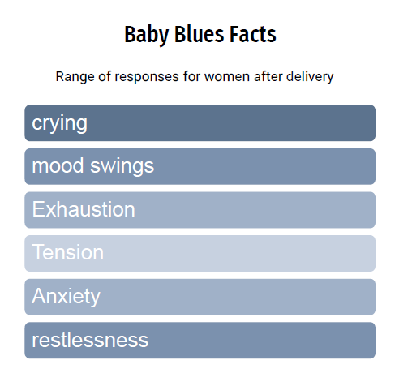
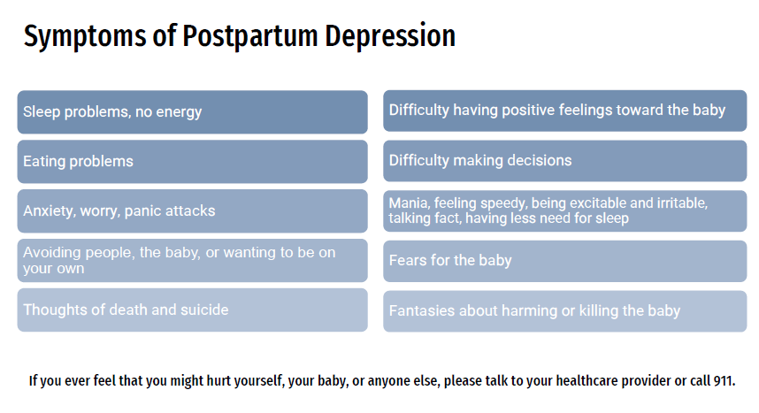
Depression is most likely to occur when pregnant or within 12 months postpartum.
The most under-diagnosed obstetrical complication in the US:
  As many as 1 in 7 women have been shown to experience maternal depression.
  7%-15% within the first three months postpartum
2

Slide 3
Difficulties having positive feelings towards baby
Delayed love for baby is not uncommon
Factors such as exhaustion, depression can lead to feeling “shut down.”
A difficult or colicky baby can make it hard
to have quiet/quality time with baby
3

Slide 4
If you are struggling, sad, alone, anxious
You are not alone.
You are not to blame.
REACH OUT
4

Slide 5
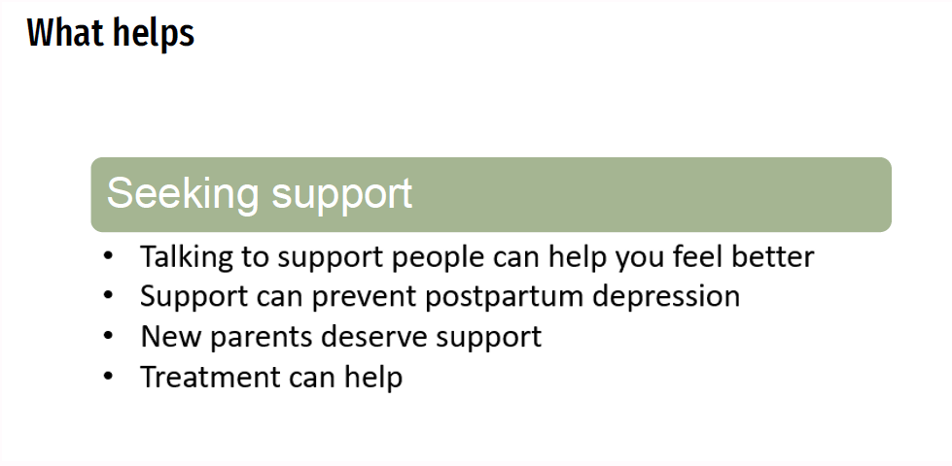
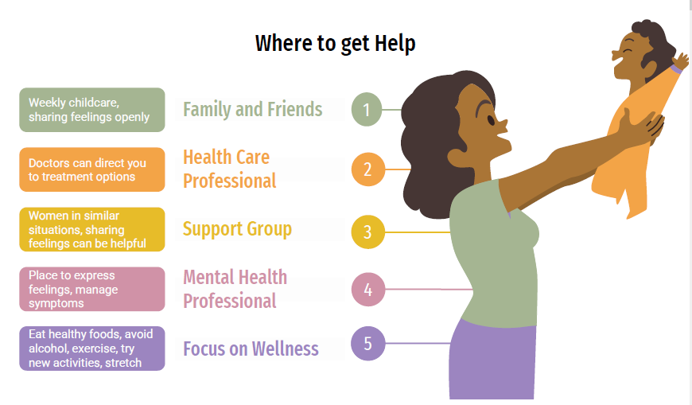
5

Slide 6
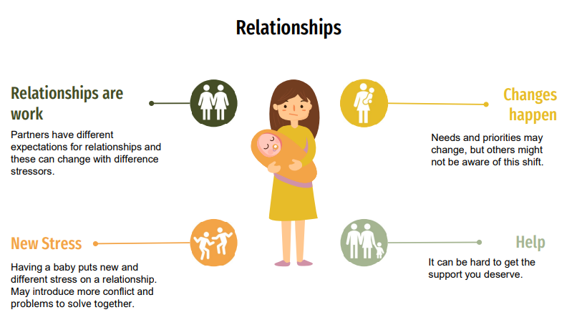
6

Slide 7
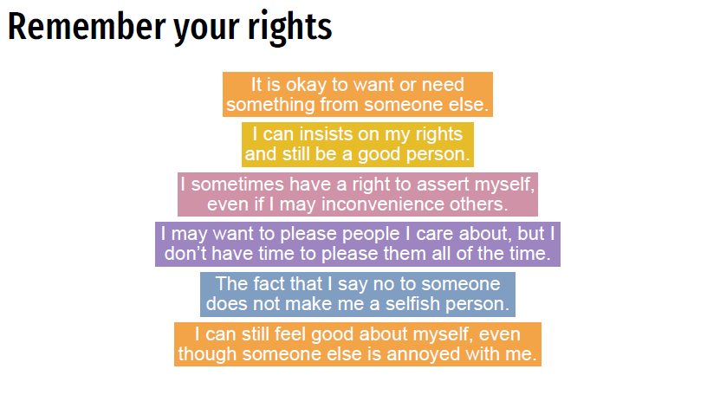
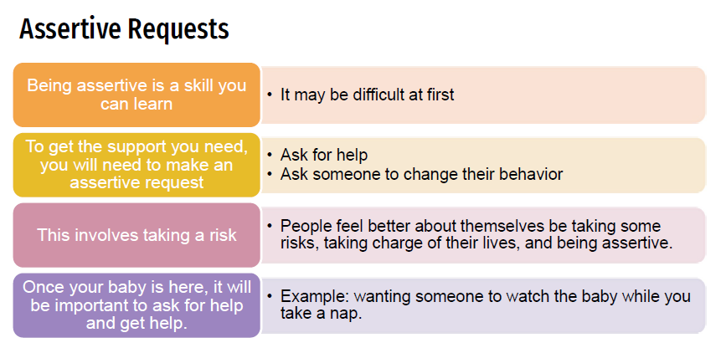
7

Slide 8

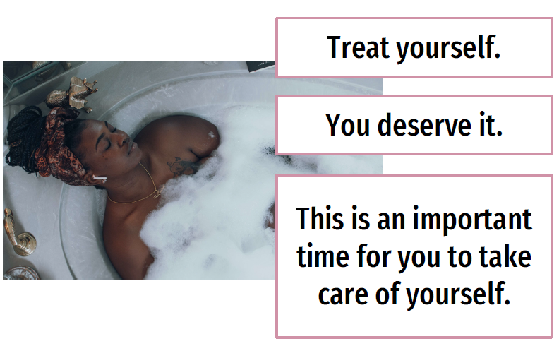
8

Slide 9
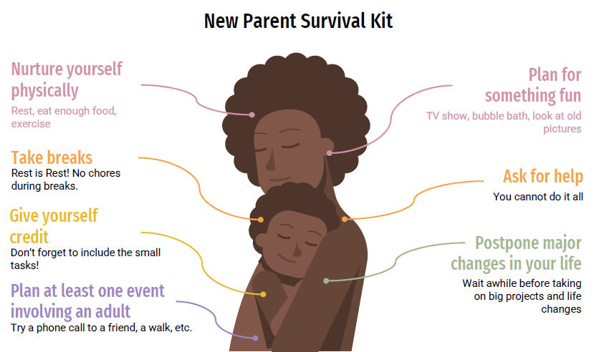
9

Slide 10

Celebrate yourself
Reward and celebrate your efforts and successes
Give yourself credit, even for the small things that you do as a partner, sibling, friend, and parent.
10

